Slide 1
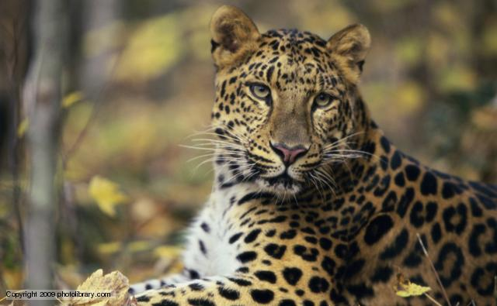
Leopard News
2017-2018 School Year

Slide 2

Sports- Volleyball
Smith vs. Palo Alto Oct 11th
7th grade home and 8th grade away
Tickets cost $2
B team starts at 5:30pm
A team starts at 6:30pm

Slide 3

Sports- Football
Smith vs. Palo Alto Oct 10th
7th grade at Palo Alto
8th grade at Ellison HS
Tickets cost $2
B team starts at 5:30pm
A team starts at 6:30pm

Slide 4

Sports- Cross Country
Meet Saturday, Oct 14th at Long Branch Park

Slide 5

Choir Concert:
Thursday, Oct 11th at Ellison HS starting at 6:30pm

Slide 6
Coding Club:
As been canceled for this Thursday, Oct 11th.

Slide 7
Finals Week:
Tuesday: Electives
Wednesday: ELAR & History
Thursday: Math & Science

Slide 8
Coming up Events:
Early out Friday, Oct 13th school releases at 1:05pm.
Remind your parents of the release time.

Slide 9
IDs:
Students your ID must be worn around your neck with the appropriate colored lanyard.
  6th grade- Yellow
  7th grade- Red
  8th grade- Green
If you lose your ID you can purchase a replacement for $5.

Slide 10
Announcements-
Students remember to wear your IDs and make sure that they are out and visible at all times.
Students remember that backpacks are not allowed in the classrooms.

Slide 11
Announcements-
Students check the lost and found located on the ramp to the stage.

